Slide 1
Group 2 Capstone
Capstone Team 2:
Kathy A. Brett
Vamshi Krishna Jonnada
Nicole L. Justice
Kishore K. Kovuru
Jessica Reyes
Notes:
Vamshi

Slide 2
Problem statement
Crime is an unwelcome issue within any neighborhood. While this has a public safety impact, it is also assumed to have a monetary impact with the potential to have a negative effect on home sale values. Little is known regarding the impact of local crime statistics on how a tax auditor determines residential home sale values for Charlotte, NC. This creates limitations for homeowners, buyers, sellers, and real estate agents at being able to make good decisions about home sales transactions.
Notes:
Vamshi

Slide 3
Focus Questions
Do high crime rates drive housing prices in all neighborhoods in Charlotte?
Is there a specific type of crime that influences changes in housing prices?
Do we see more changes in house sale prices during a specific time frame?
Does proximity to major highways drive higher crime rates?
Does the number of rental housing units in a neighborhood affect crime rates?
Is there a correlation between crime rates and public nutrition assistance rates?
Notes:
Vamshi

Slide 4
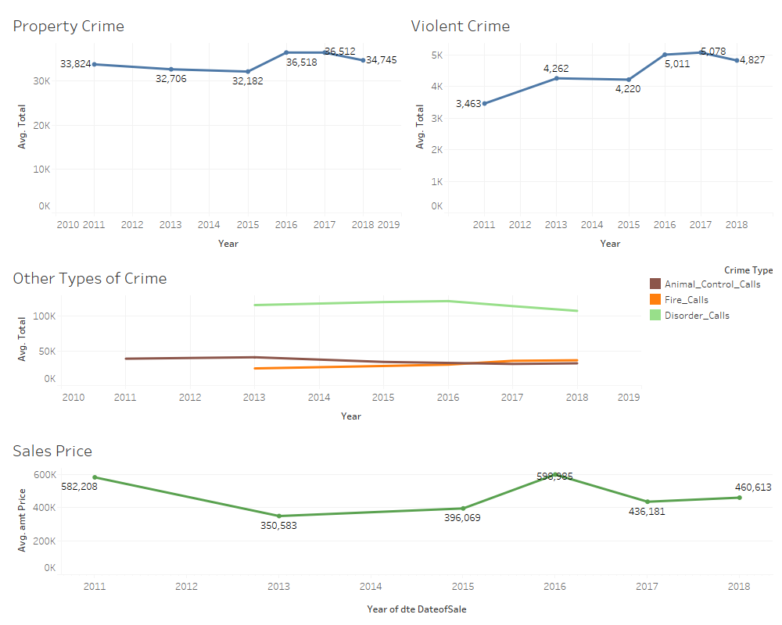
Time Series Trend Analysis
Notes:
Jessica

Slide 5
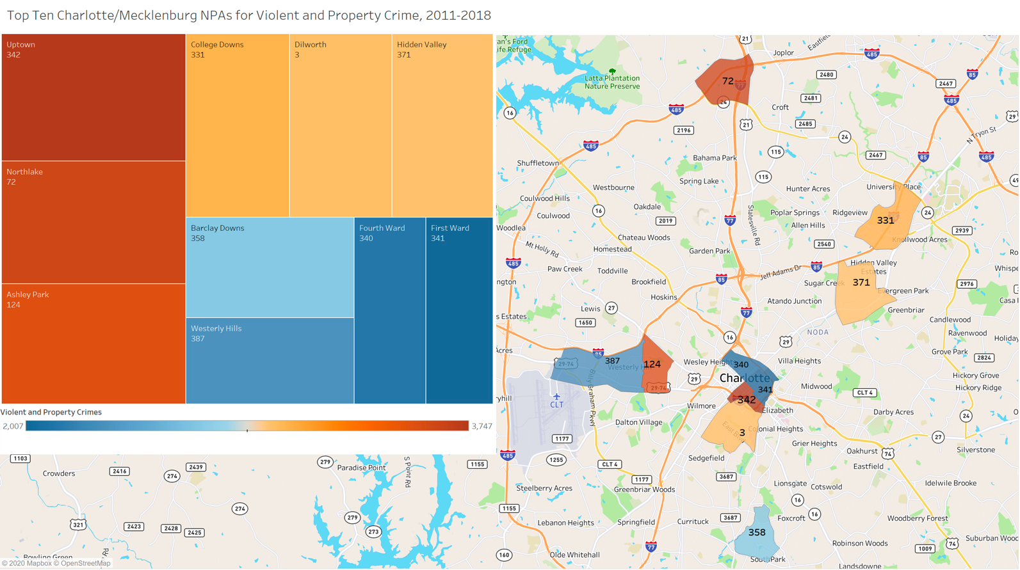
Top Ten NPAs for Violent and Property Crime 2011-2018
80% of the NPAs (Neighborhood Profile Areas) with high rates of violent and property crime in Charlotte are close to a major highway.
Notes:
Jessica

Slide 6
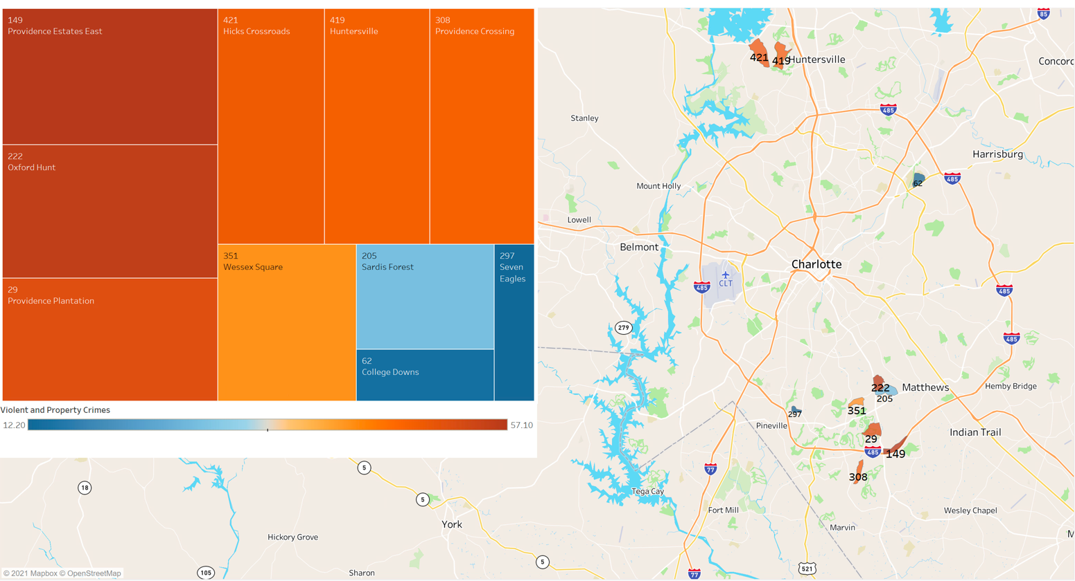
Bottom Ten NPAs for Violent and Property Crime, 2011-2018
The neighborhoods with the lowest violent and property crime appear to be further away from major highways.
Notes:
Jessica

Slide 7
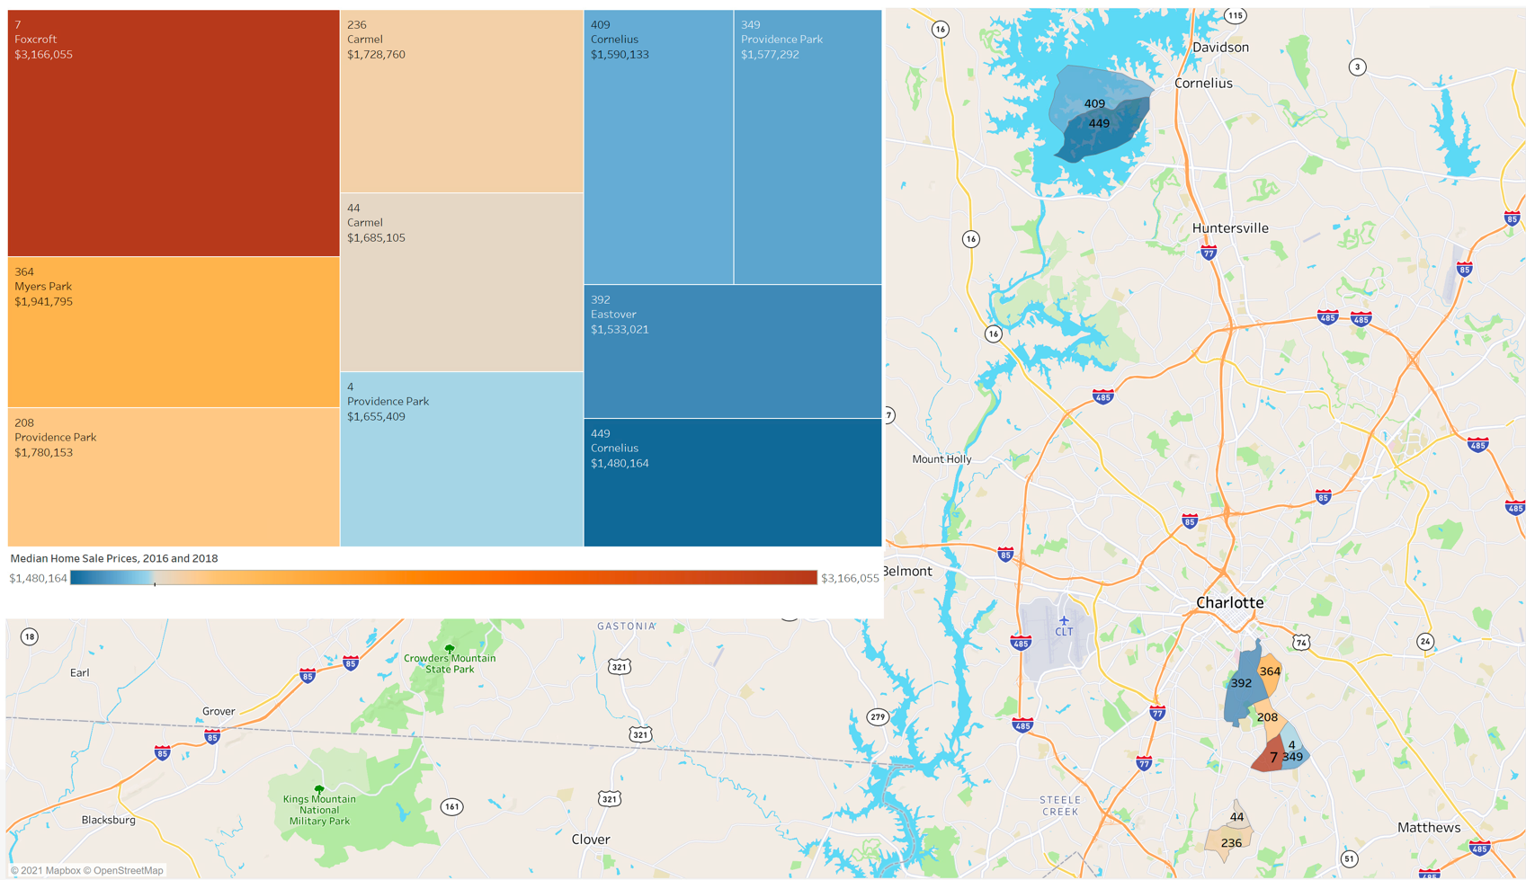
Top Ten NPAs for Median Home Sale Prices, 2016 & 2018
The neighborhoods with the highest home sale prices overall tend to be further away from both major highways and higher crime neighborhoods.
Notes:
Kishore

Slide 8
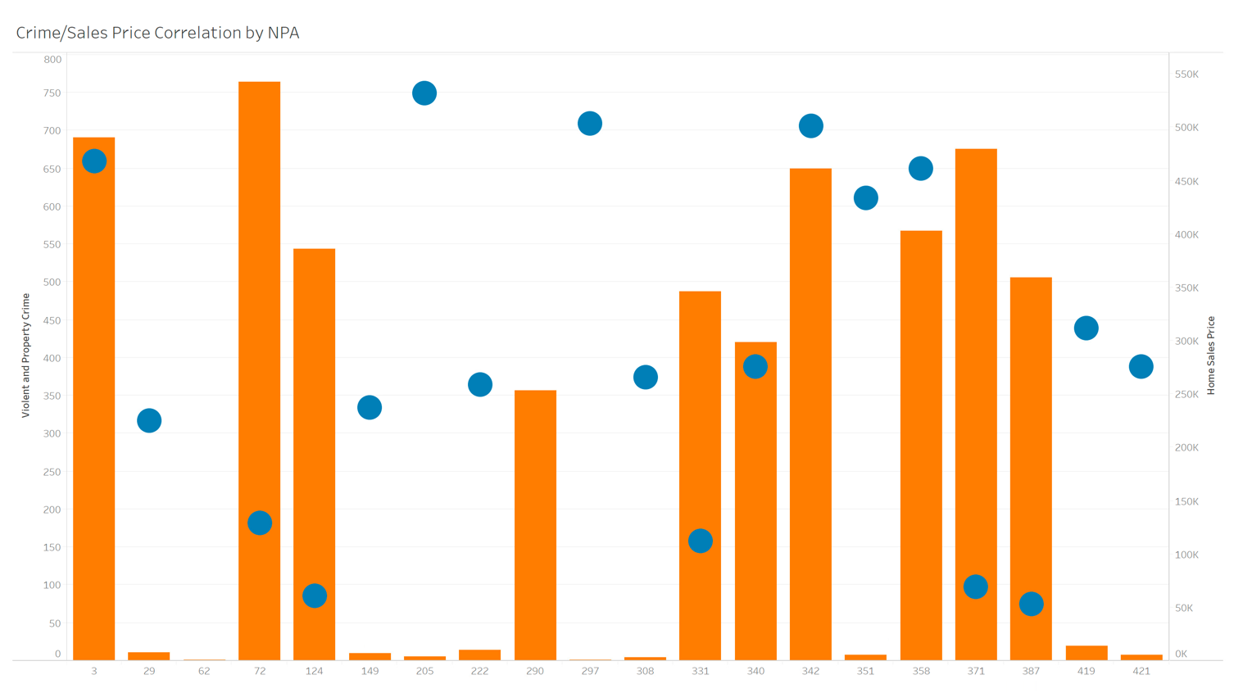
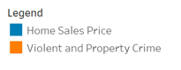
Crime/Sales Price Correlation by Neighborhood
Notes:
Kishore
There are some exceptions for commercial neighborhoods in terms of home sale prices. Some commercial NPAs have a high volume of crime, but the home sale prices go up the following year. Note: there was no sales data for 290.

Slide 9
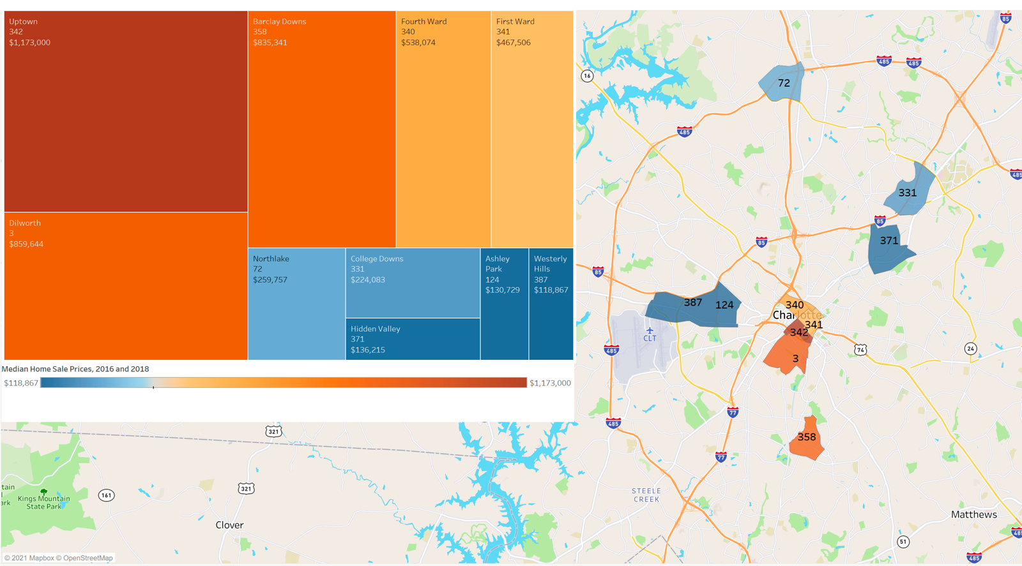
Home Sale Prices of Top Ten NPAs for Crime, 2016 & 2018
Uptown (342) is industrial, 61% of which is commercial construction, malls and restaurants
Dilworth (3) is the central business district of Charlotte
Barclay Downs (358) has luxury boutiques, high-end electronic and retail stores and stylish international restaurants
Fourth Ward (340) has walkable streets to restaurants, museums and music clubs
Notes:
Nicole

Slide 10
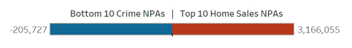
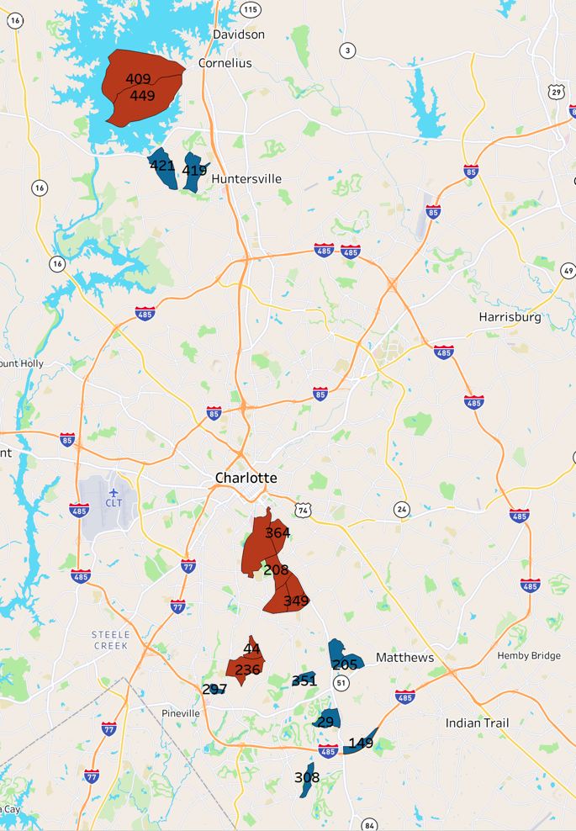
Are the Bottom Ten NPAs for Crime in the Top Ten NPAs for Home Sale Prices?
No, but geographically, they are close.
Notes:
Nicole

Slide 11
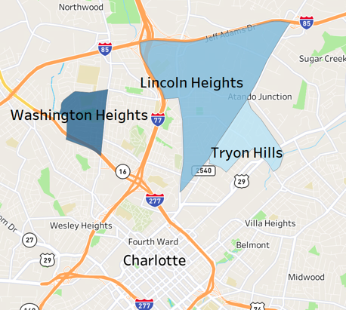
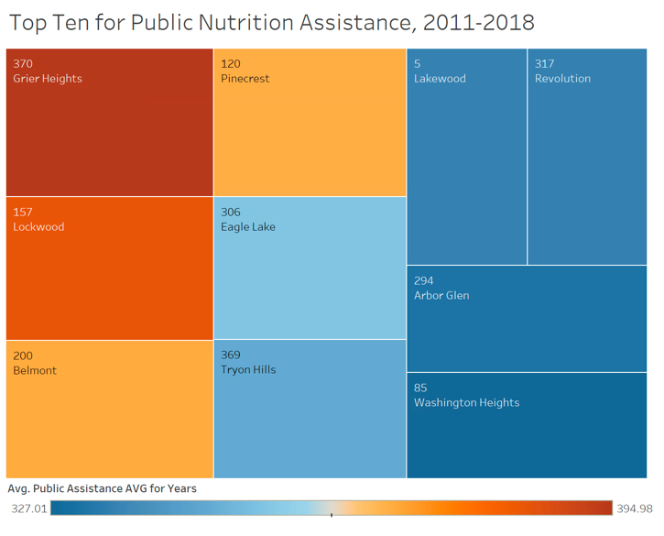
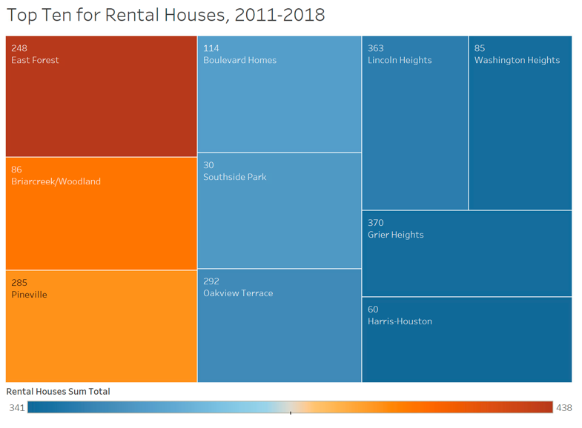
Other Variables Considered
Among the Top Ten NPAs for Public Nutrition Assistance and Rental Houses, the 3 NPAs above are included in the lowest total house price sales during 2011-2018.
However, none of them are in the Top Ten for Violent and Property Crime.
Notes:
Kathy
However, 3 out of 10 NPAs were represented in the bottom ten for lowest home sale prices. There was insufficient home sales data for 50 NPAs. 5 of the 50 are in the top ten for public nutrition assistance and rental units. Additional data may change results.

Slide 12
Conclusions
Our time series analysis shows an increase in crime rates and a decrease in the median home sale prices for the following year. Higher violent and property crime rate is associated with lower median house price.
Violent crime and property crime appear to have more of an impact on home sale prices than other types of crime.
Initial analysis indicates a correlation between higher crime rates in neighborhoods closer to major highways, but further analysis is necessary.
There does not appear to be a correlation between public nutrition assistance, rental units and higher crime rates.
There are some exceptions for commercial neighborhoods in terms of home sale prices. Some commercial NPAs have a high volume of crime, but the home sale prices go up the following year.
Notes:
Kathy

Slide 13
Learnings
A lot of this was trial and error. We were always learning based on initial results, especially in Tableau.
Gathering the data was a big challenge. We couldn’t retrieve home sales data for all the years we needed.
There was also a big challenge in processing specific data. With so many sources for data, it was sometimes difficult to focus on one specific area.
A positive learning: when scope is aligned, the data sticks with you. The data starts speaking to you when you visualize it.
All the previous courses in our cohort were crucial to our analysis at this stage.
No data analysis effort is truly complete. In 5 years, the data (and our results) will likely change.
Machine learning will help us provide new solutions in the future.
Notes:
Kathy

Slide 14
Thank you!
Jarrod Adams
Jeremy Adams
Shanthi Anand Rao
Pryia Bhasin
Kathy A. Brett
Vinod Chintalapudi
Susan Cook
Wesley Douglas
Mark T. Gilligan
Greg Hodge
Madison Holdsworth
Vamshi K. Jonnada
Tyler Joswick
Matthew Kohut
Kishore Kovuru
Chang Liu
Sreenivasa R. Machapalli
David Millikin
Sid Nayak
Matthew Nowak
Grace Perkins
Mark Prass
Jessica Reyes
Christina D. Rubel
Colleen Saunders-Chukwu
Tara Sheffer
Mark Steinhelper
Greg Tatusko
Laura Titas
Jim Tyo
Randy VanWashenova
Weiyan (Joy) Zhao
Columbus State Community College
FutureU
Nationwide Enterprise Analytics Office
Nationwide Insurance
Nationwide Technology
Past, present and future cohorts
(And all our managers and loved ones, of course.)
Notes:
Nicole

Slide 15
Questions?
Notes:
All

Slide 16
Appendix

Slide 17
References
DATA:
Charlotte/Mecklenburg Quality of Life Explorer (http://mcmap.org/qol/)
Over 80 variables providing info about housing, crime rates and more
Maps, trend information, data tables and summary reports for 462 neighborhood profile areas (NPAs)
Open Mapping - Mecklenburg County GIS (http://maps.co.mecklenburg.nc.us/openmapping/data.html?search=sales )
Parcel sales data for Mecklenburg from 2011-2019
STUDIES:
https://proceedings.esri.com/library/userconf/proc03/p0122.pdf
https://www.ncjrs.gov/pdffiles1/nij/grants/209263.pdf
https://www.ncjrs.gov/pdffiles/164488.pdf
https://www.researchgate.net/publication/283555834_Highway_Robbery_Testing_the_Impact_of_Interstate_Highways_on_Robbery
https://www.onlinelibrary.wiley.com/doi/full/10.1111/jors.12491

Slide 18
Analysis Approach
To determine if a correlation exists between crime rates and residential sales prices, our analysis included the following:
Neighborhood crime “hotspot” comparison in the greater Charlotte, NC area
Time series trend analysis for those hotspots with the highest and lowest crime rates against home sales prices over the last 5 years, including by type of crime
Crime rates and highway proximity studies
Comparison of neighborhoods with the highest crime rates against those with the highest public nutrition assistance rates
Comparison of neighborhoods with the highest crime rates against those with the highest number of rental units

Slide 19
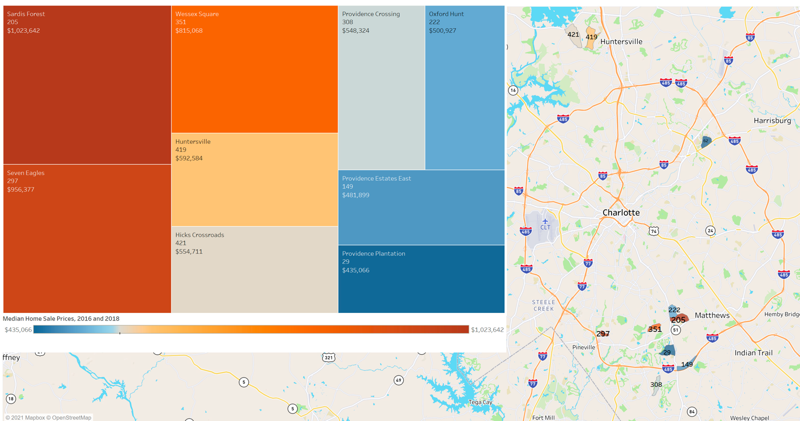
Home Sale Prices of Bottom Ten NPAs for Crime, 2016 & 2018

